Slide 1
Block Matrix Inverse
Yunkai Xiao y84181445

Slide 2
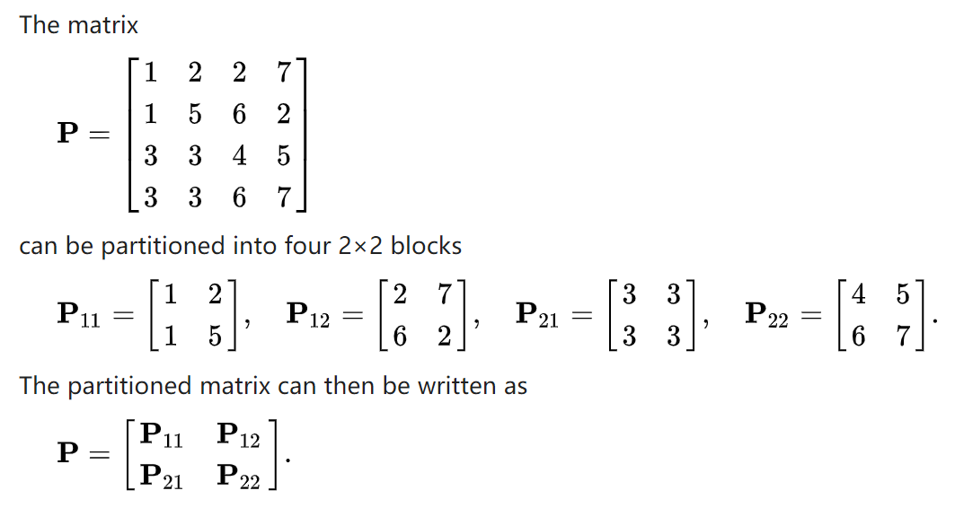
Block Matrix
Algorithm Introduction

Slide 3

Inverse Algorithm
Lower Triangle Matrix:
$\left[\begin{matrix}A_{11} & 0 \\ A_{21} & A_{22}\end{matrix}\right]$
The inverse should be
$\left[\begin{matrix}A_{11}^{−1} & 0 \\ {{−A}_{22}^{−1}A}_{21}A_{11}^{−1} & A_{22}^{−1}\end{matrix}\right]$

Slide 4
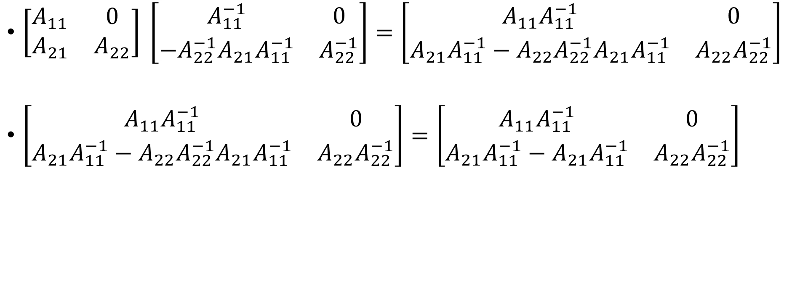
Simple proof
$\left[\begin{matrix}A_{11} & 0 \\ A_{21} & A_{22}\end{matrix}\right] \left[\begin{matrix}A_{11}^{−1} & 0 \\ {{−A}_{22}^{−1}A}_{21}A_{11}^{−1} & A_{22}^{−1}\end{matrix}\right]=\left[\begin{matrix}A_{11}A_{11}^{−1} & 0 \\ A_{21}A_{11}^{−1}−A_{22}{A_{22}^{−1}A}_{21}A_{11}^{−1} & A_{22}A_{22}^{−1}\end{matrix}\right]$
$\left[\begin{matrix}A_{11}A_{11}^{−1} & 0 \\ A_{21}A_{11}^{−1}−A_{22}{A_{22}^{−1}A}_{21}A_{11}^{−1} & A_{22}A_{22}^{−1}\end{matrix}\right]=\left[\begin{matrix}A_{11}A_{11}^{−1} & 0 \\ A_{21}A_{11}^{−1}−A_{21}A_{11}^{−1} & A_{22}A_{22}^{−1}\end{matrix}\right]$

Slide 5
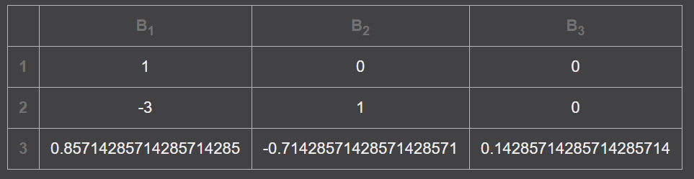

Demo
Input:
$\left[\begin{matrix}1 & 0 & 0 \\ 3 & 1 & 0 \\ 9 & 5 & 7\end{matrix}\right]$

Slide 6
Time Complexity
T(n) = 2 * T(n/2) + n^3/4
T(n) = (log(n)*n^3)/4

